Slide 1
WHAT IS GIT AND GITHUB
By Ankit Verma

Slide 2
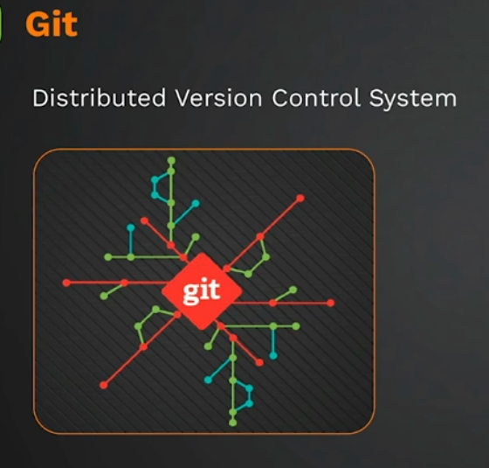
Version control is a system that tracks changes to files and directories over time, allowing multiple people to collaborate on a project or manage the evolution of a set of files. It is commonly used in software development but can also be applied to other types of projects where tracking changes is essential, such as documentation, design files, or configuration files.
For ex: We see apps getting updated overtime! Right? So there must be some connections between prev. version and new version which helps in running the system smoothly. Git helps us at that place to co-ordinate between all versions. We can check out the previous versions also using Git.

Slide 3
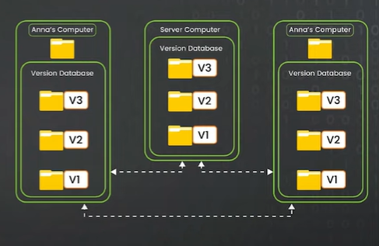
Git Snapshot
State of the project/ code at a given moment of time.
When you tell Git to – commit
my changes, it will result in
something called as my
snapshot (as shown in the
diagram)

Slide 4
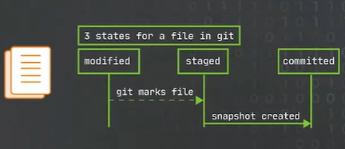
Git States
Modified: When we create a file and make changes in it. It gets into the modified state.
Staged: It reads our code and goes into the process of adding the code into itself.
Commit: After you've staged
your changes, you're ready to
create a new commit. A
commit is a snapshot of the
entire project at a specific
point in time, including all the
changes you've staged. As soon
as it’s committed, we get a new
Snapshot.

Slide 5
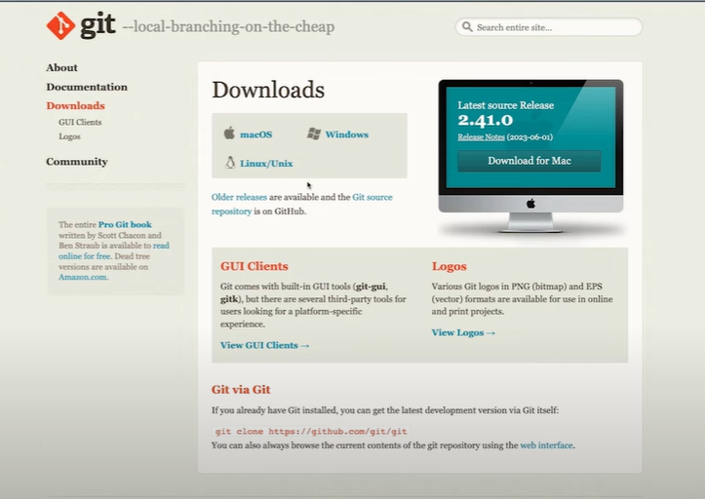
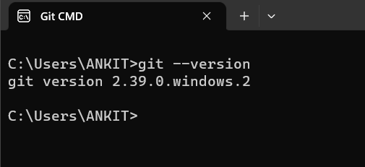
Installing Git
Go to Chrome, Type “Install Git”
Click on first link and download it
as per your device compatibility.
To check which version has been
installed:
Open Git CMD → Type “git --version”

Slide 6
Git Functions/Properties
git config –global user.email “ankitvsv0311@gmail.com”
git config –global user.name
git config –global user.name “Ankit Verma” // your name shown globally
git config user.email // displays your email
git config user.name // displays your name
mkdir demo // used to create a folder called “demo”
cd demo // lets me go inside the folder
git init // initializes git with the ownership of handling the folder
// a new hidden file “.git” is created which has all the info. about version control
cls // clears screen
Now create a text document file called “file1”
(We can create a folder manually also!)
(Any file which starts with “.” is a hidden file and it contains all the configurations and setups which is needed by git to do version control here)

Slide 7
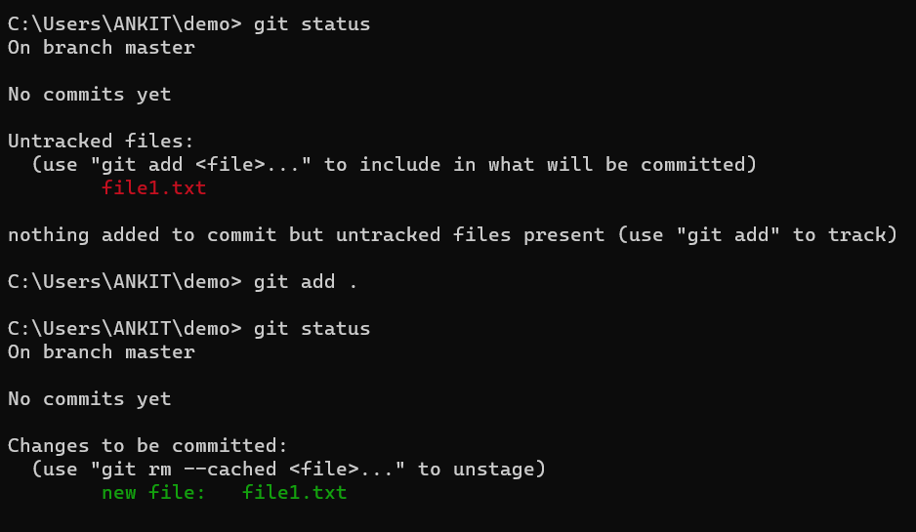
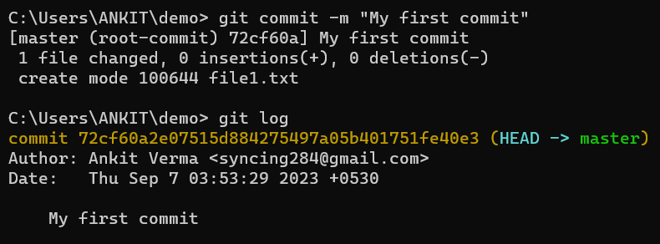


git status // we created and modified. Now we need to tell git to trace it.
git add . // used to trace file
git status // checking updated version
git commit –m “my first commit” // Now change is done and we are creating a snapshot which is the state of the project at that given point of time. “<logical message so that one can understand why that change was committed>”
git log // used to check prev. versions
// Create a new text document file called “file2.txt”
//Repeat the above steps and do “git log”
(Anytime we make changes, it’s followed by “git add .”, followed by “git commit –m “message”)
(Latest commit is also known as “Head” )
(commit id)

Slide 8
Now suppose we have done a mistake and we want to undo it. Then there are 3 parts at where we can undo :
Create/Modify → Undo at this level
Add → Undo at this level
Commit → Undo at this level
(There should be some info. in file so that we can confirm the undo’s!)

Slide 9
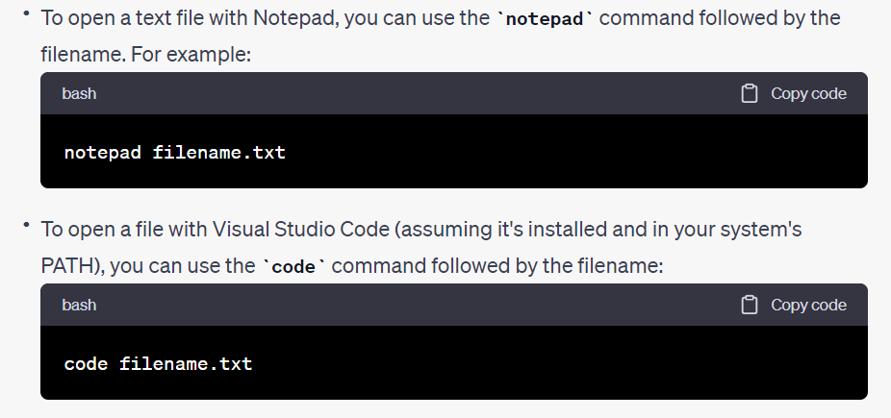
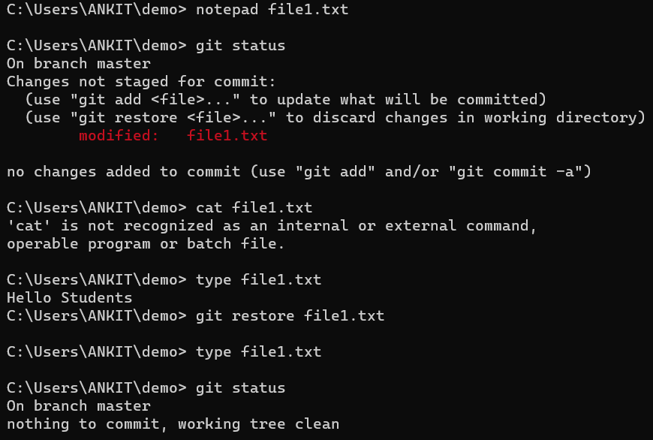


Undo Modification
(you can type “dir” to check out what all files are present in the folder)
We can undo it by typing “git restore file1.txt”

Slide 10
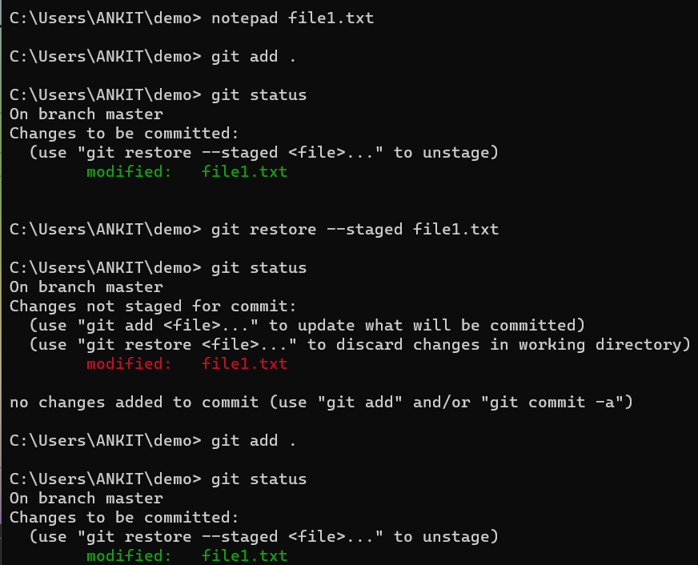
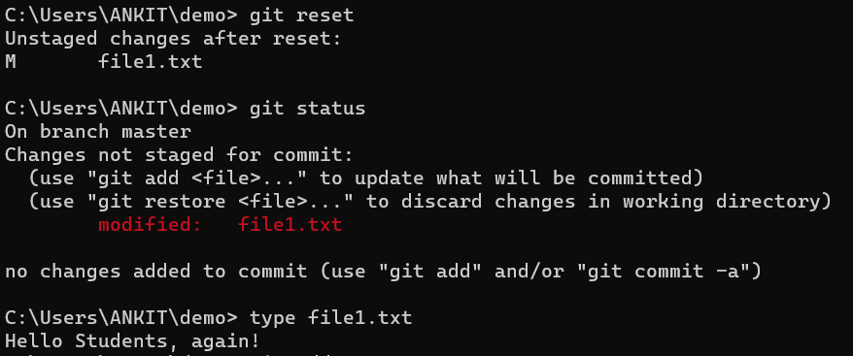
Undo Add
If we want to undo, by default Git CMD gives us its method to undo it : (use "git restore --staged <file>..." to unstage)
2nd method to undo it is by typing :
“git reset”

Slide 11
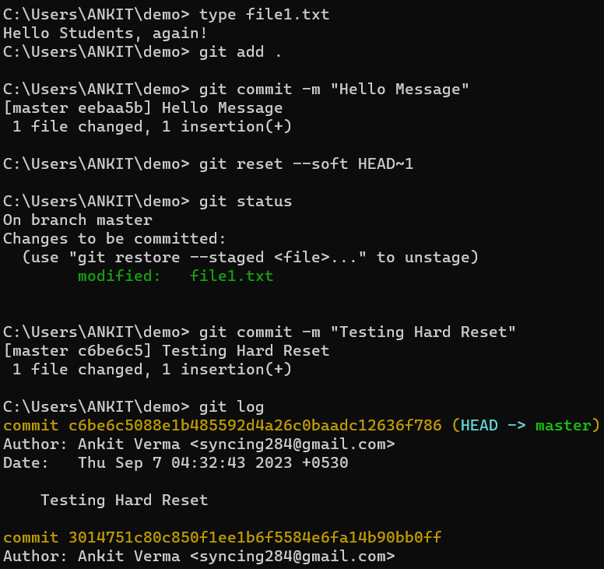
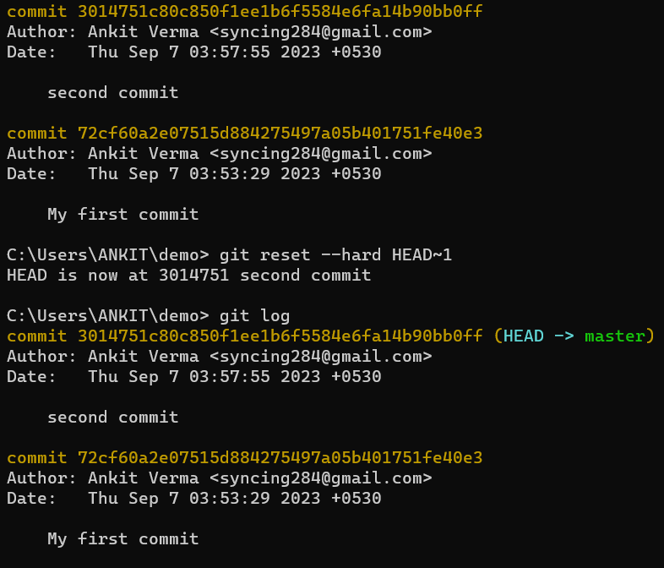
Undo Commit
There are 2 ways to undo:
1) Soft way : “git reset --soft HEAD~1”
2) Hard way : “git reset --hard HEAD~1”
(Here ‘1’ signifies how many positions we want to go back)

Slide 12
Difference between Soft Reset and Hard Reset
In simple terms:
Soft Reset: Imagine you have a document with some corrections you haven't saved yet. A soft reset is like moving your cursor to a previous point in the document without losing your uncommitted changes. You can continue editing from that point.
Hard Reset: Now, think of the same document, but with a hard reset, it's like moving your cursor to a previous point and erasing everything after that. You lose all your uncommitted changes and go back to that earlier point in the document.

Slide 13
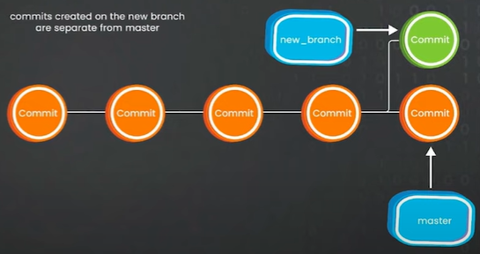
Git Branches
Branch is basically a pointer that points to a snapshot points
Each branch is independent of other
Nowadays we are naming branch name as: Master / Main
It helps us run multiple features in parallel
Branches are imp. because, for ex: C1→ C2→ C3 (head)
If we are adding our code (incomplete and irrelevant to output) to C3 and suppose after sometime the C3 crashes! Then we have to undo all the things(including our hard written code) and check where is the error. So to avoid this we make branches.
We will see now; How do we create branches, How do we switch to branches, and merge two branches

Slide 14
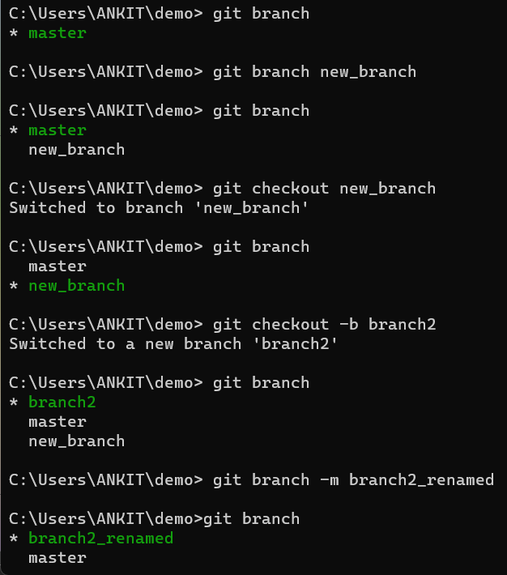
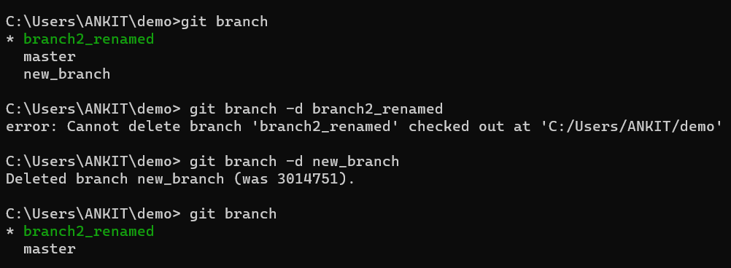
Creating Branches
To check which branch we are in currently: “git branch”
To create a new branch:
“git branch branchName”
To switch to another branch:
“git checkout otherBranchName”
If we want to create and switch at the same time: “git checkout –b branchName”
If we want to rename a branch:
“git branch –m newBranchName”
If we want to delete a branch:
“git branch –d toBeDeletedBranchName”
(You can’t delete the branch in which you are currently functioning)
(New branch is pointer to the existing snapshot)2

Slide 15
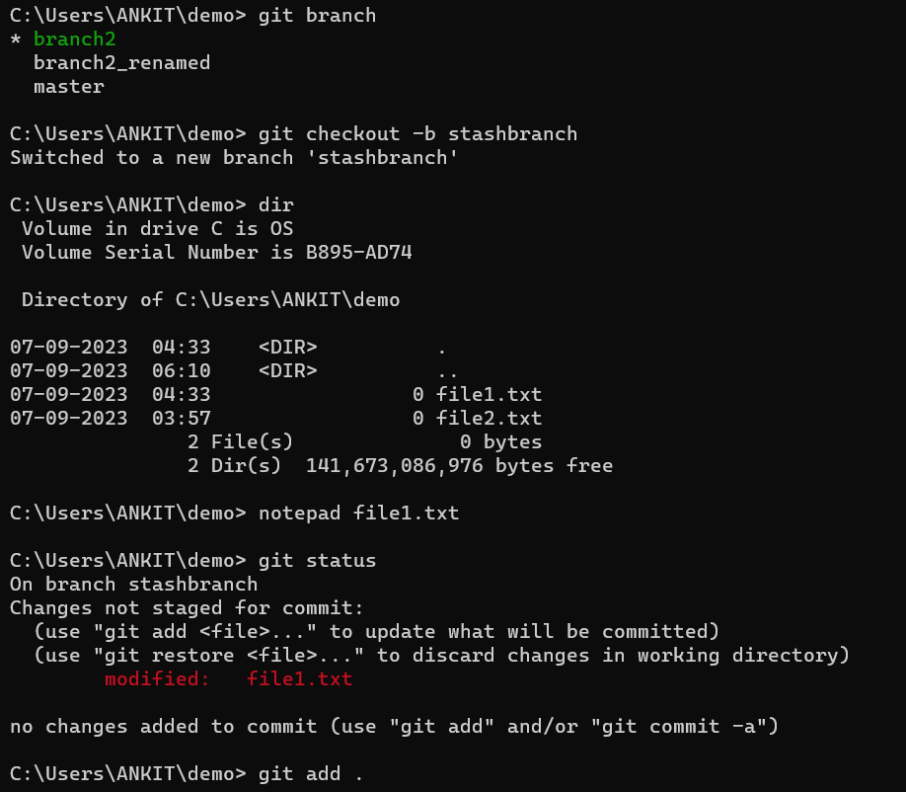
Git Stash
Suppose we are working on A, but an urgent work B came, so in order to save the progress of A we use “git stash” property which saves the data locally.
(Work on B now solved)
Now we use “git stash apply” property to
get back the last saved progress of A.
Let’s check it out in code:
Here we made a new branch: stashbranch
// saved “Hello World !” in file1.txt

Slide 16
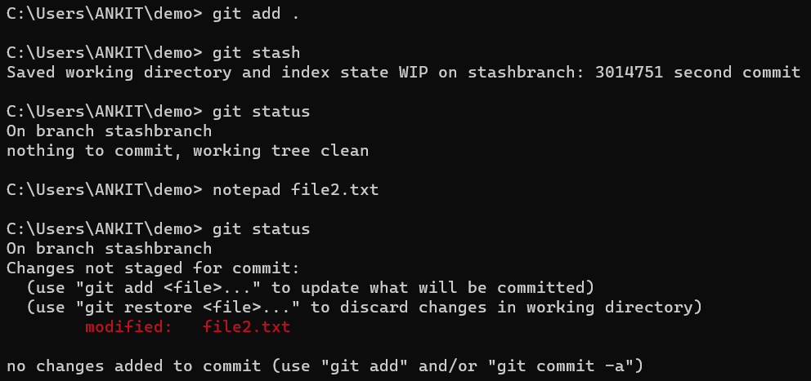
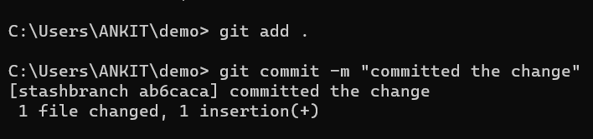
We save our progress in git stash.
Checking git status
Doing work on file2.txt (wrote “Changes” for saving)
Saved file2.txt and checking git status
Committing the changes of another file

Slide 17
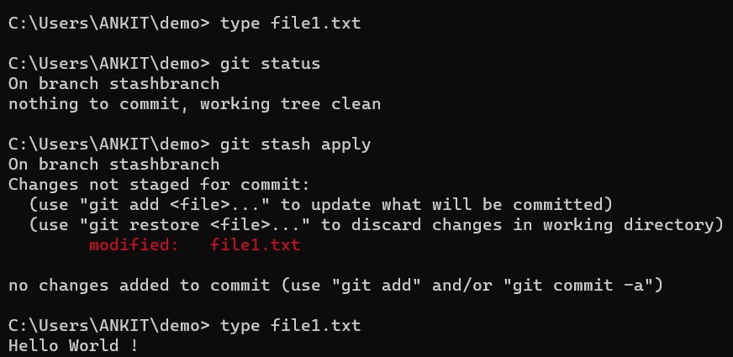
Checking the data of file1.txt
(shows nothing, so its empty)
Checking git status
Recovering our file1.txt data
Checking our file1.txt recovered data (“type file1.txt”)

Slide 18
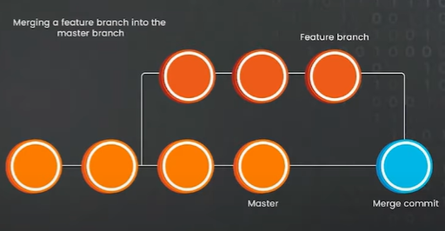
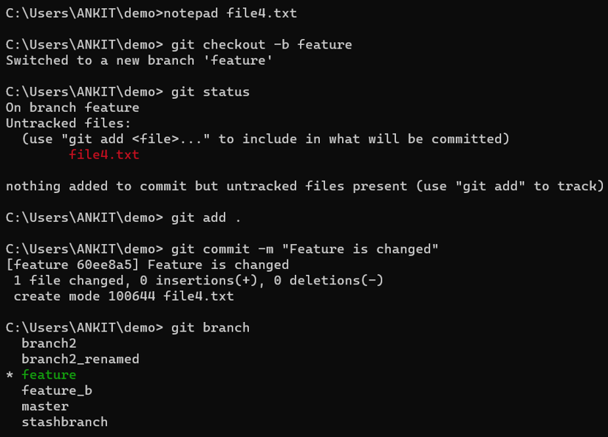
Merging Branches
Merging is done to bring different features in an application.
Here we created new file4.txt (info. Stored “Feature is changed”.
We make a new branch, track it and commit it!
Now we shift to master branch ( the branch where we have to merge)

Slide 19
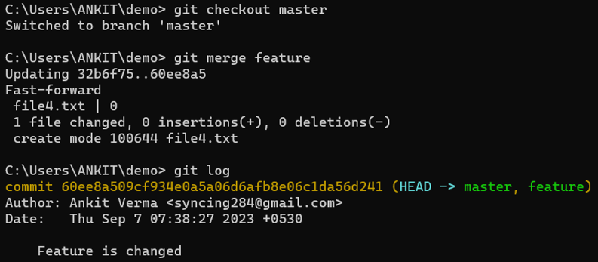
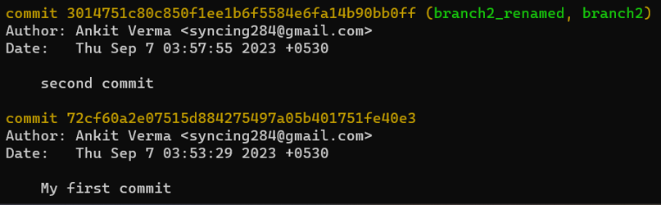
We now type: “git merge (branchToBeMergedName)” so that branch gets merged.
Now we check all the changes done by “git log”.

Slide 20
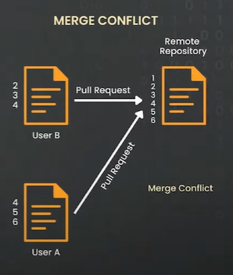
Merging Conflicts
sdaasg

Slide 25

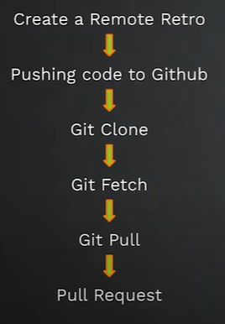
Git Remote
Now all the codes and stuff we have done on our local laptop. But what if my laptop crashed or it is lost? How can we share our codes to our colleagues working on the same project
Github: A Remote Code hosting Platform
(Right figure: Things we will learn)
Repository

Slide 26
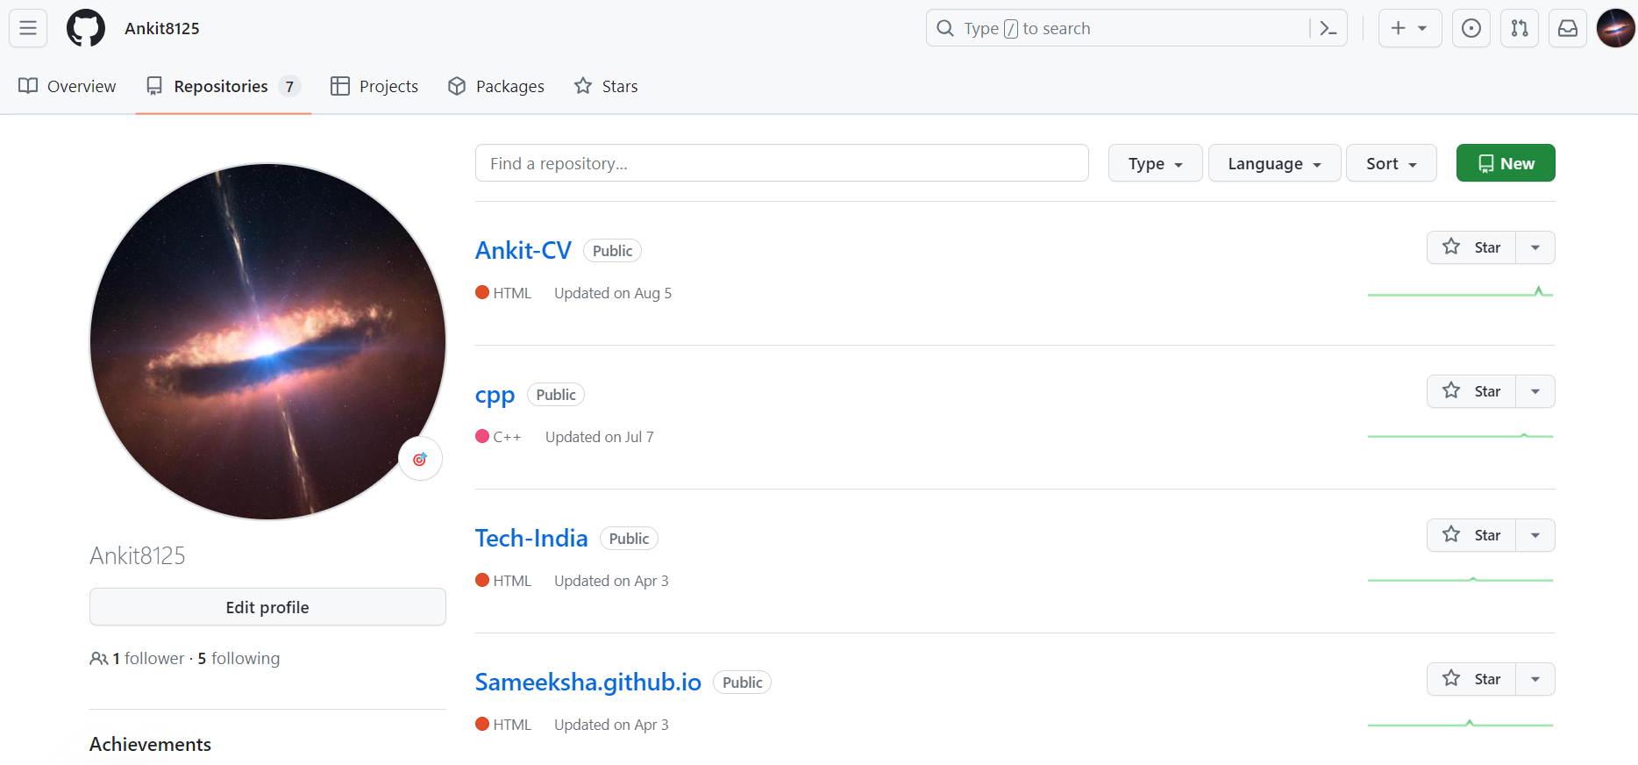
Create your account on “github.com”
Your opening interface should look something like this:
Repositories are basically the logical name under which your entire code base will be stored

Slide 27
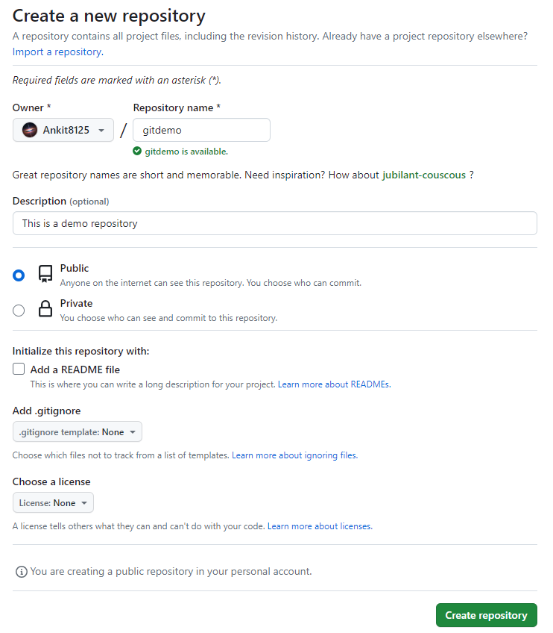
Making new Repository
Click on “New” or “+” symbol at the top to create a new repository.
Description defines what this project does, so it’s better to update it
README file is more of like a file which contains the information about the projects. It’s pretty helpful and almost all the good repositories that you see in the market will have this readme file.
.gitignore file is like a list of things you don't want to put in your backpack when going on a trip. It tells Git, "Don't include these files in my project." It helps keep your project tidy by leaving out stuff like temporary files or secrets that you don't want to share or track.
Choose a license is an option provided by GitHub to help project maintainers easily select and add an open-source license to their repositories. This feature simplifies the process of adding a license file to your project, making it clear how others can use, modify, and distribute your code.

Slide 28
So now we have created a new repository called as “gitdemo” under my profile.
Now we have code in our local machine( i.e. our laptop ) and we need →connect local to remote.
→push the code from local to remote.

Slide 29
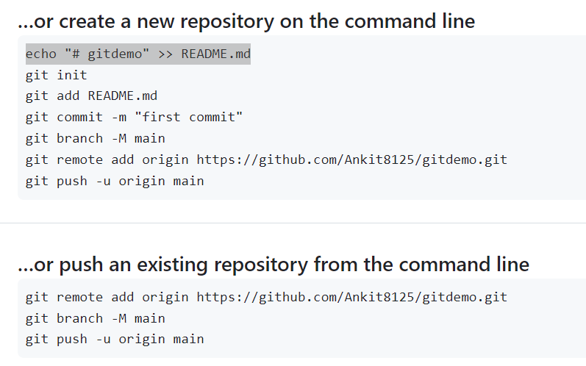
Connection local and remote
No code in my local repo
Initialising git project
(Origin = Alias name given to my device)
Adding remote repo.
------------------------------------------
If we already have files on our local comp. , then we use the below option

Slide 30
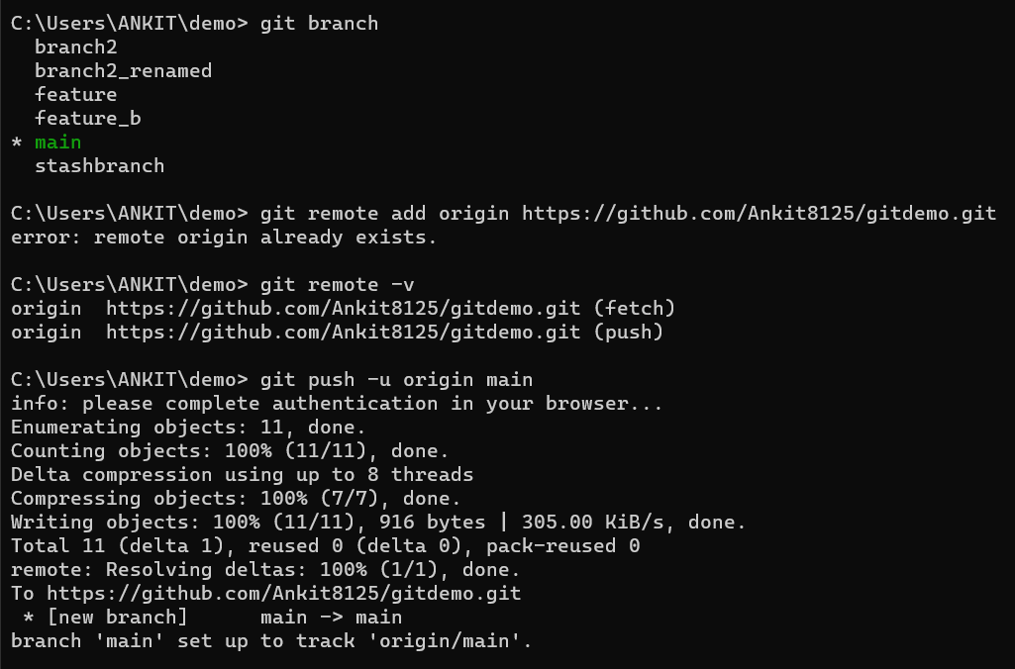
Pushing an existing repository from the command line
“git remote add origin https://github.com/Ankit8125/gitdemo.git”: Means we are adding remote to Git
“git branch –M main”: renaming our ‘master’ file to ‘main’
“git remote -v”: checking our local repository is connected to which all repositories
“git push –u origin main”: pushes code in Github
(ignore the error after git branch. You wont get that if you’re doing first time. I was actually doing it the second time)

Slide 31
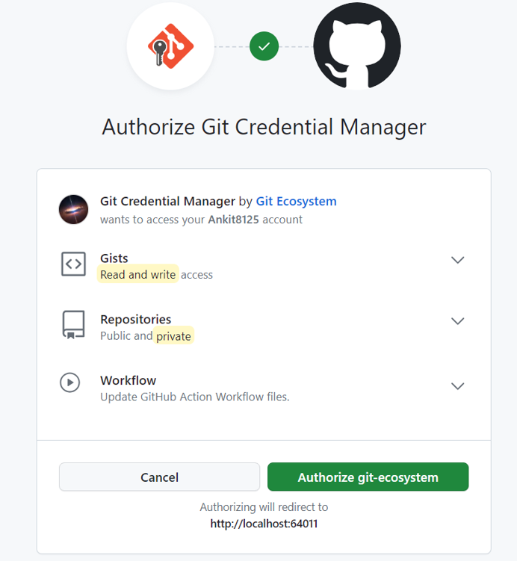
While pushing, some of you might get an interface like this!
Click on Authorize git-ecosystem and sync up.

Slide 32
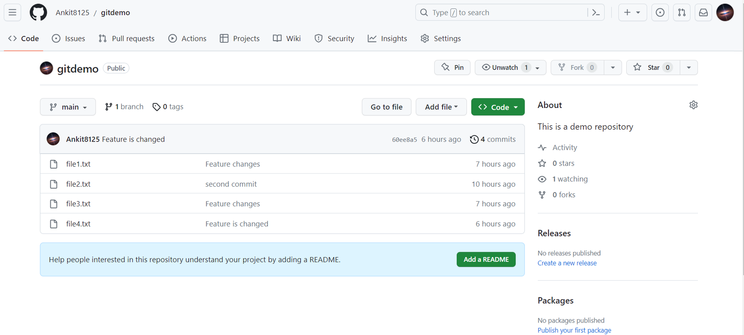
Refresh the page and you will see your screen something like this →
You can also see “4 commits” which is equivalent to showing the “git log” previously.

Slide 33
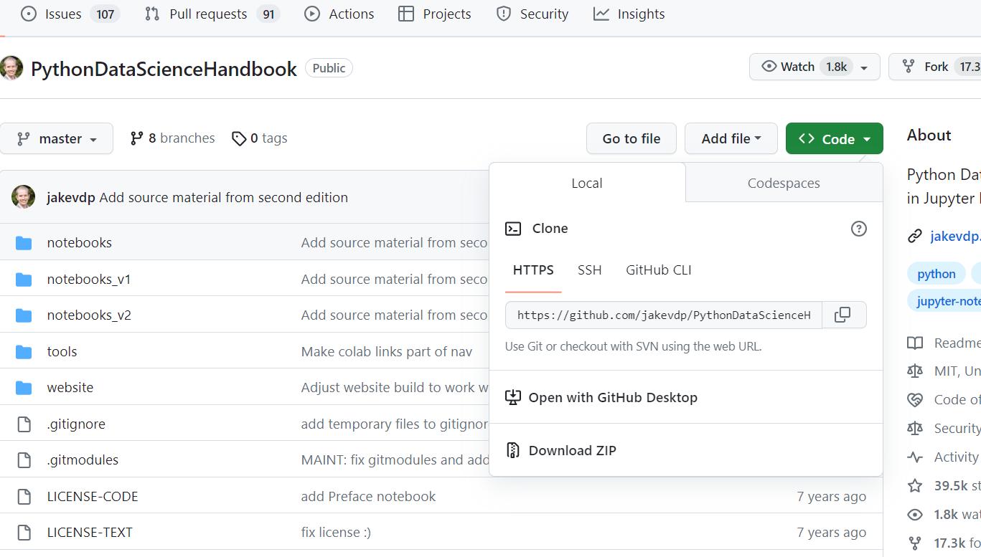
Git Clone
Suppose we are working a company in a sub-team X. Now all the codes which X stored on their GitHub, I need to bring it to my local machine. So this is known as Git Cloning.
Click on <>Code. You might see a pop-up as shown in figure. Copy the HTTPS code.

Slide 34
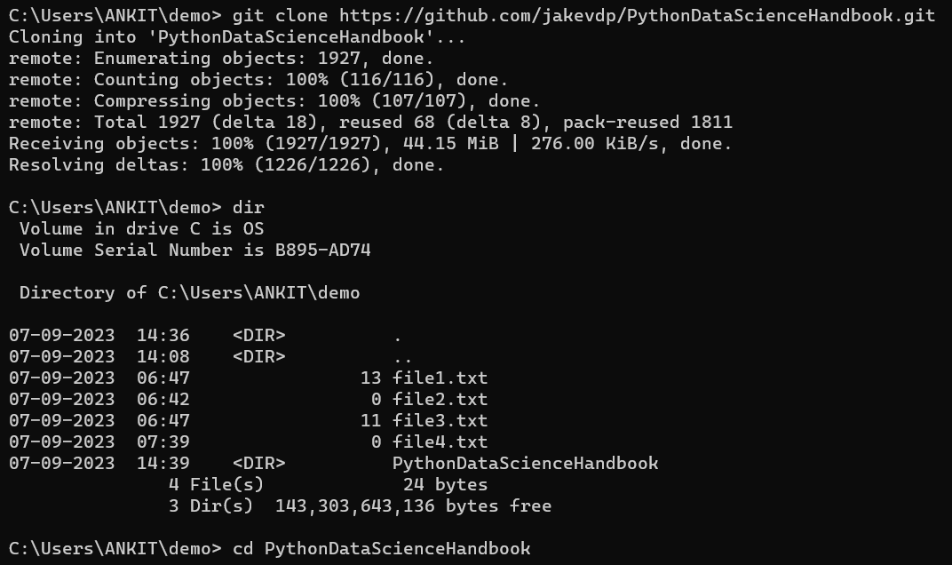
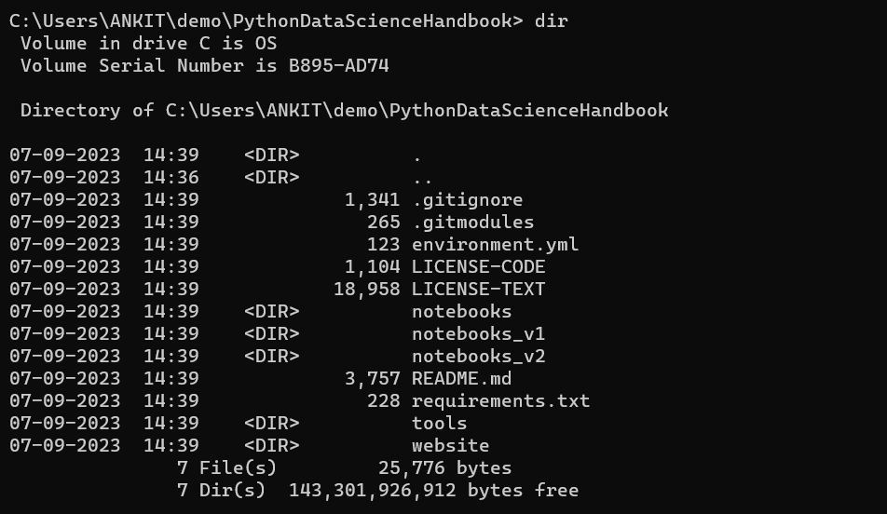
Type “git clone https://....” → This basically clones all the things from github to your local system.
Type “dir” → You can now see a new folder got created named PythonDataScienceHandbook
You can go inside that folder (cd) and check out all the things that got pasted! (dir)

Slide 35
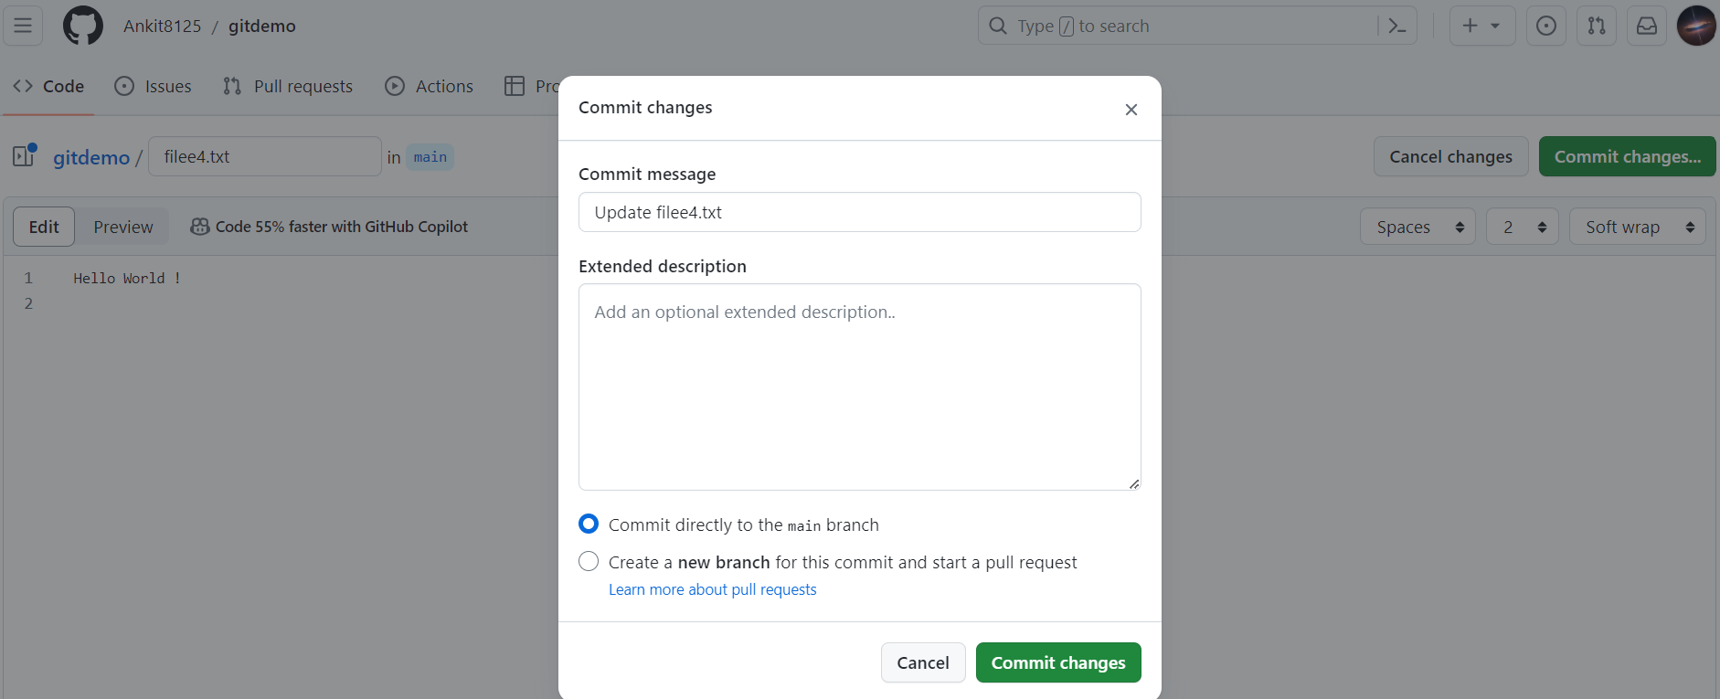
How to add updated file from remote to local?
Lets add a new file:
Go to Add file → Create new file.
Commit changes as shown in figure.

Slide 36
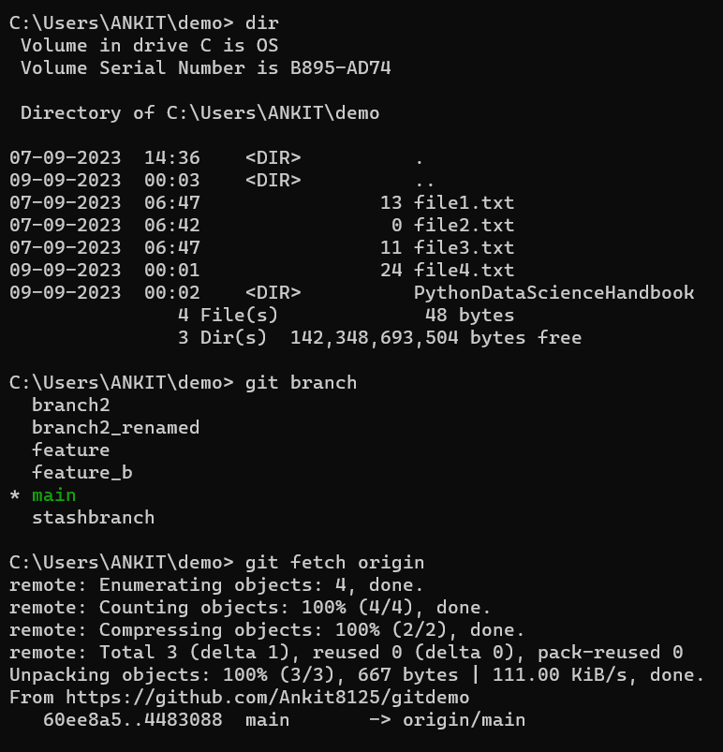
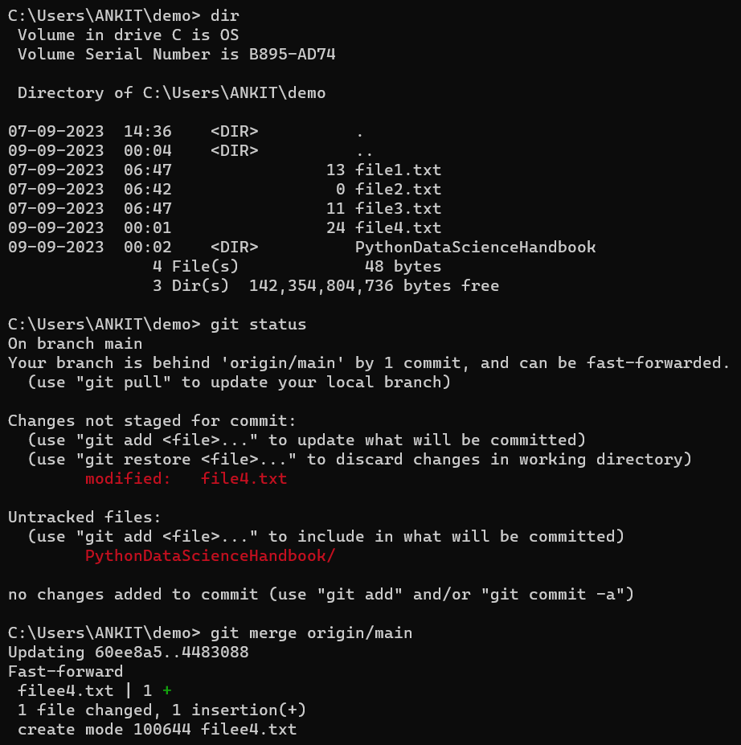
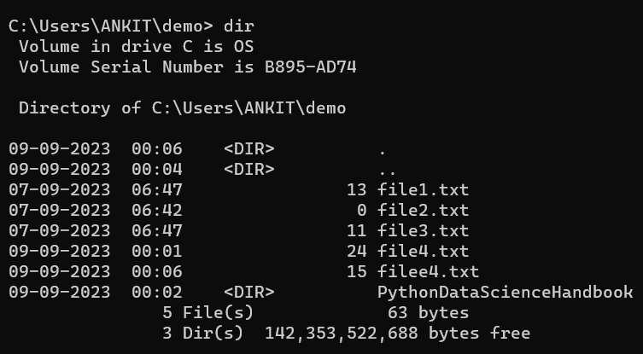
Now if someone has added new files on Github, and we are working on the prev. version. So to add the new files from remote to local is:
Type “git fetch origin”: fetches the new file from remote to local.
But as you can see in next line our new file isn’t added yet! Its behind the origin/main file
So type “git merge origin/main”. Now you file will added to your local.
Checking it out by doing dir

Slide 37
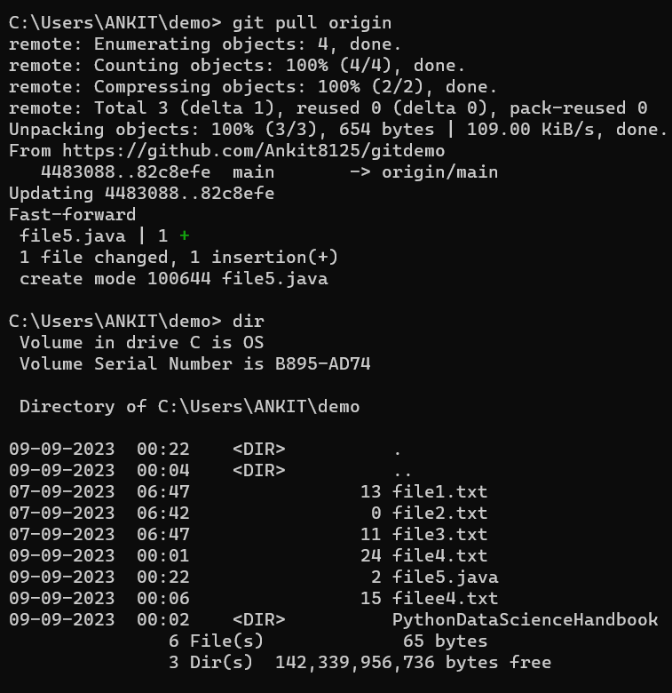
Shortcut for the above method!
Create a new file5.txt on github.
Now type “git pull origin” on Git CMD
Therefore, git pull = git fetch + git merge

Slide 38
Forking and PR ( Pull request )
Now consider we are working in a Company X. Now we want to brings its database/Git on our Git so that we can do changes on it.
Once we *fork the git (means basically copying its git to our git), we then need to bring it to our local (git clone) , so that we can edit it.
Once we edit it, we now need to send PR to the X. Now a person in X reviews our changes and it depends on him whether to reject it, comment it or accept it.
For ex: we are using X as Airbnb/javascript ( go to github and type javascript. Click on any links )

Slide 39
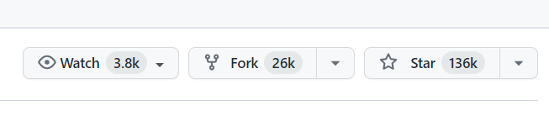
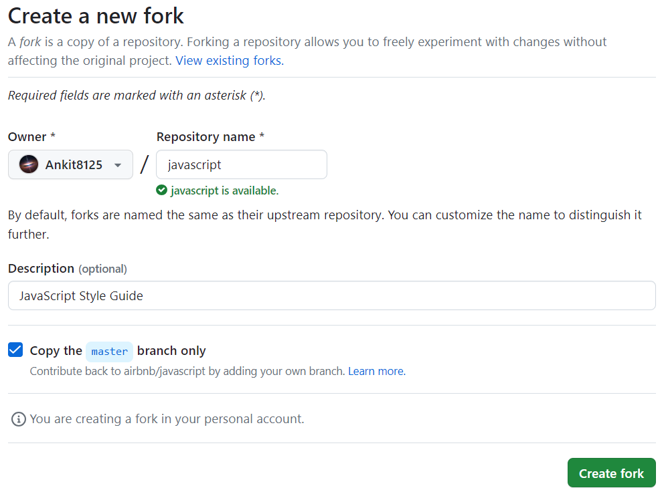
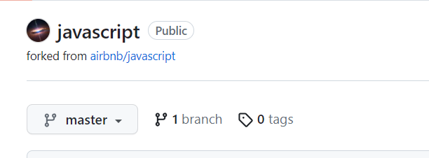
You can see “Fork” on top right hand side. Click on it.
Click on “Create Fork”.
Now you can see that javascript is copied to your Github and its showing “forked from airbnb/javascript”

Slide 40
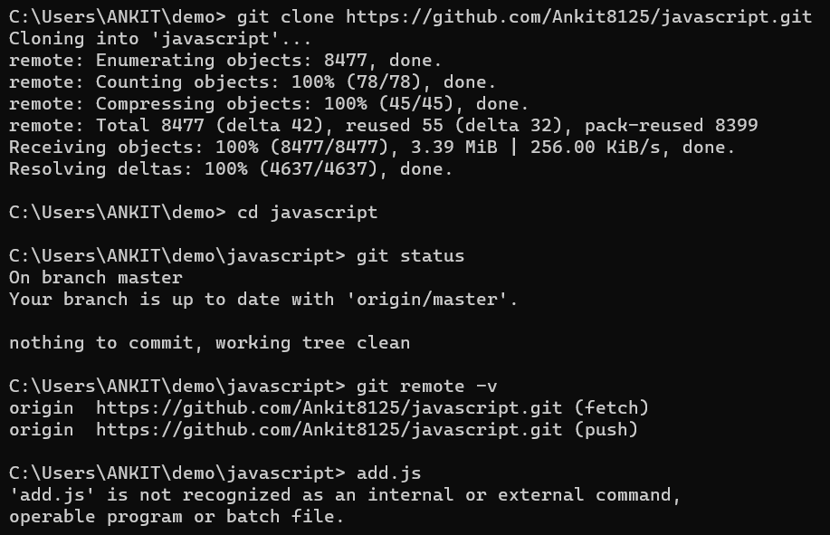
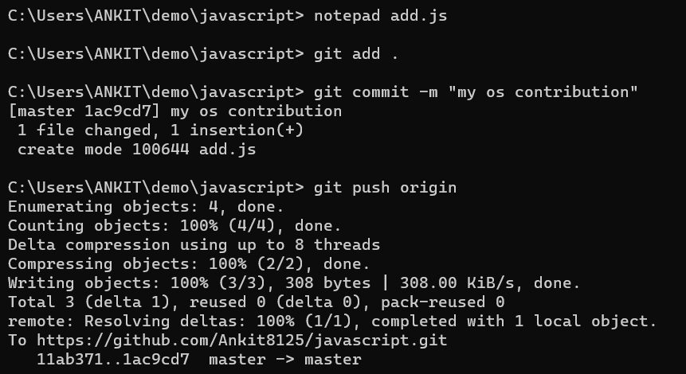
Now copying the HTTPS code and cloning it in our system
Cloning it → Opening javascript folder → Checking status and git remote –v ( to see all connections to repo )
Creating a new file add.js(making our changes)
Adding → Committing
Now pushing our changes from local to our github.
You can refresh your github and checkout your new updated file.

Slide 41
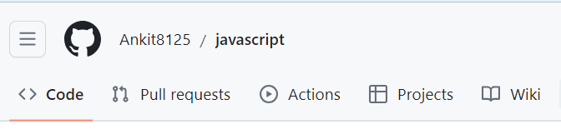
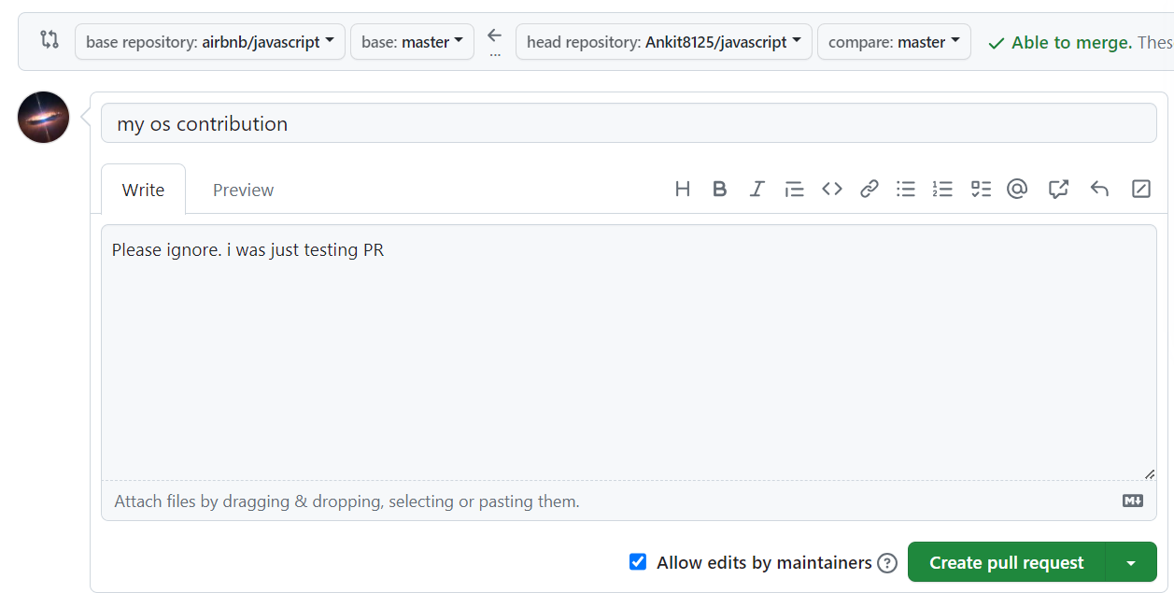
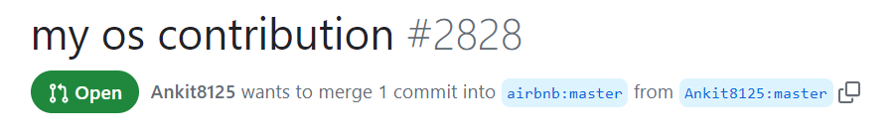
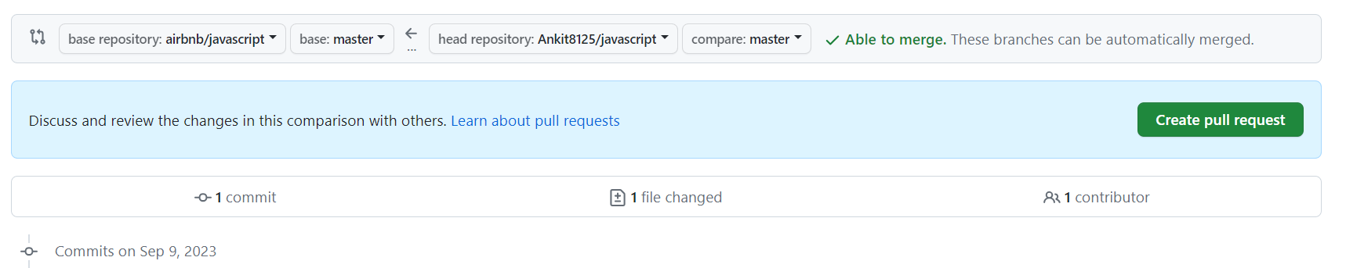
Now go to Pull request on top left hand side.
New Pull request
Write a description so that the reader understands why we made the change or something like that.
Create pull request.
The no. #2828 shows that my PR is the 2828th request to airbnb.
Target
Current

Slide 42
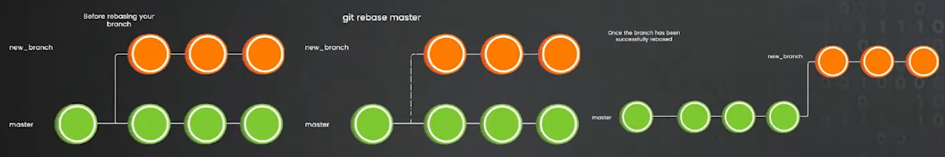
Rebasing Branches
“git rebase” helps us maintain a very clean commit base history.

Slide 47
Conflict during rebase

Slide 50
Rebasing Vs Merge
Rebasing → no new commits are made
Merge → creation of new merge commits
If multiple people are working on the same branch and they all are trying to do the rebasing so it will kind of corrupt your main branch. So in this case you should not use rebasing. If only one person is working then its better to rebasing.
In a nutshell, both rebasing and merge helps you to make sure that all the changes could be brought to one single phase which you can deploy into the production.

Slide 51
THANK YOU

